Slide 1
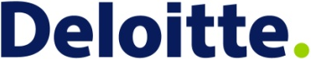
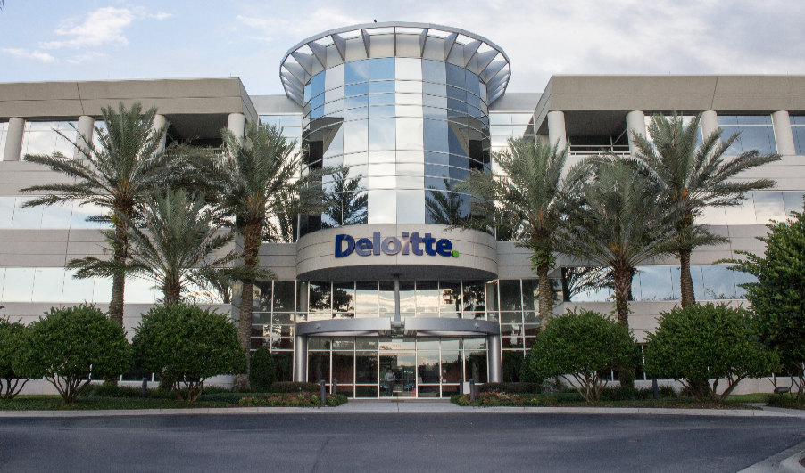
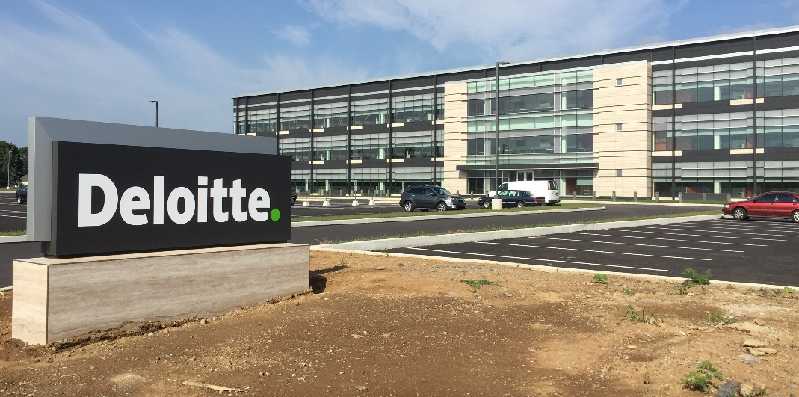
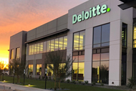
USDC Information Technology Center of Excellence (IT-CoE)
Topic: CompTIA Security+ Testing Review
Orlando, FL
Mechanicsburg, PA
Gilbert, AZ

Slide 2
Todays Security Threats
Session 1
Security+
CompTIA Security+
Test: SYO-601
EXAM OBJECTIVES (DOMAINS)
The table below lists the domains measured by this examination and the extent to which they are represented:
Domain | Weight
1.0 Threats, Attacks and Vulnerabilities | 24%
2.0 Architecture and Design | 21%
3.0 Implementation | 25%
4.0 Operations and Incident Response | 16%
5.0 Governance, Risk, and Compliance | 14%
Total | 100%
Today’s Session – Chapter 1 and 2
Objective 1.5 Explain different threat actors, vectors, and intelligence sources
Objective 1.6 Explain the security concerns associated with vulnerabilities.
Objective 2.1 Explain the importance of security concepts in an enterprise environment
Objective 5.1 Compare and contrast various types of controls.

Slide 3
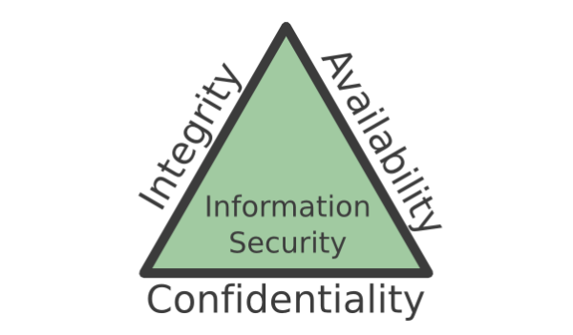
Session 1
Security+
Todays Security Threats
The CIA Security Triad
A model to guide policies for information security within the entire organization.
Confidentiality is the set of rules that limits access to information to only those that are authorized to use the information. Security controls include user ids, passwords, ACLs, policy-based security, and encryption.
Integrity is the assurance that the information is trustworthy and accurate. Ensures that it is edited by only authorized persons and remains in its original state when at rest. Data encryption and hashing are processes to ensure integrity.
Availability is a guarantee of reliable access to the information by authorized individuals. Hardware maintenance, software patching/upgrading, and network optimization ensures availability.

Slide 4
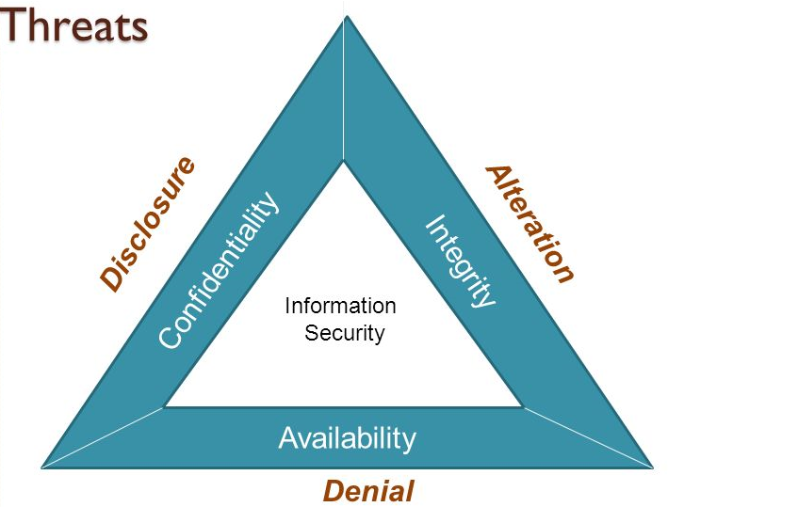
Session 1
Security+
Todays Security Threats
Threats to the Principles of Security - The DAD Triad
Disclosure is the exposure of sensitive information to unauthorized individuals. This is a violation of the security principle of Confidentiality. Attackers gain access to sensitive information and copy it to be disclosed later. This is data exfiltration.
Alteration is the unauthorized modification of information and is a violation of the principle of Integrity. Attackers can modify records for financial or personal gain. Alterations can also be accidental or unintentional and must be monitored and prevented.
Denial is the disruption of an authorized user’s legitimate access to information and information systems. Denial events violate the principle of Availability. Denial events can be intentional or accidental, or unintended such as a power outage.

Slide 5
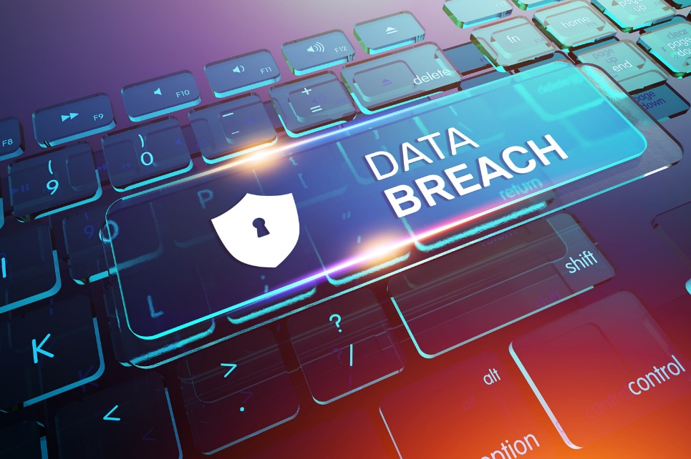
Session 1
Security+
Todays Security Threats
Impacts of Data Breaches
Financial Risk – Monetary damage to an organization as a result of the data breach. Cost of contract experts for incident response and forensic analysis.
Reputational Risk – Negative publicity around a data breach and loss of goodwill among customers, employees, and suppliers.
Strategic Risk – Risk of loss of data to the strategic plans of the organization.
Operational Risk – Risk of ability to carry out day-to-day functions. Slow down in deliver of customer orders, etc.

Slide 6
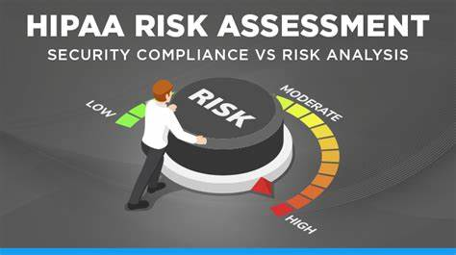
Session 1
Security+
Todays Security Threats
Impacts of Data Breaches
Compliance Risk – Causes the organization to be out of compliance to legal or regulatory requirements, such as HIPPA, PCI-DSS, etc.
HIPPA – Health Insurance Portability and Accountability Act (1996) requires health-care providers and other entities to protect the CIA – Confidentiality, Integrity, and Availability of PHI – Protected Health Information.
If data breaches occur … data is lost… then sanctions and fines to the company will occur.
Sept 23, 2020 - Business Associate Fined $2.3 Million for Breach of 6 Million Records and Multiple HIPAA Failures
https://www.hipaajournal.com/business-associate-fined-2-3-million-for-breach-of-6-million-records-and-multiple-hipaa-failures/

Slide 7
Todays Security Threats
Session 1
Security+
Implementing Security Controls
Defense in Depth Security is centered around implementing a series of Controls in place to reduce risk.
Security Control Categories
Technical – Controls implemented through technology. They may be deterrent, preventative, detective, or compensating. But not administrative.
Example, firewalls, IDS, IPS, encryption
Operational – processes to manage technology such as access reviews, log monitoring, and vulnerability management.
Managerial or Administrative – A control that is implemented through policies, procedures, and guidelines. Such as periodic risk assessments, security planning exercises, change management, and project management practices.

Slide 8
Todays Security Threats
Session 1
Security+
Implementing Security Controls
Security Control Types
Deterrent – intended to warn an intended attacker that they should not attack. These include posted warnings, locks, barricades, or anything that can delay or discourage an attack
Preventive – intended to stop something from happening. Firewalls as an example.
Detective – intended to uncover a violation or attack.
Example: An alarm that sounds when a door is opened, etc.
Corrective – Correct a situation to prevent the recurrence of errors. Remediate security events that have already occurred. Restoring backups after a ransomware attack.
Compensating – Backup controls that come into play when other controls fail.
Physical – Physical controls such as fences, locks, alarms, lighting, fire suppression systems.

Slide 9
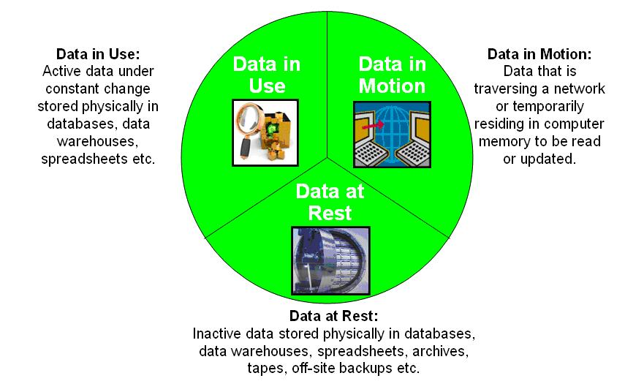
Todays Security Threats
Session 1
Security+
Data Protection Techniques
Data States
Data at Rest – stored data that resides on hard drives, tapes, in the cloud, or other storage media.
Data in Motion – data in transit over a network. At risk of eavesdropping attacks by anyone with access to the network.
Data in Processing – data actively in use by a computer. Data stored in memory while processing is taking place. Attackers may be able to copy and read sensitive data in memory.

Slide 10
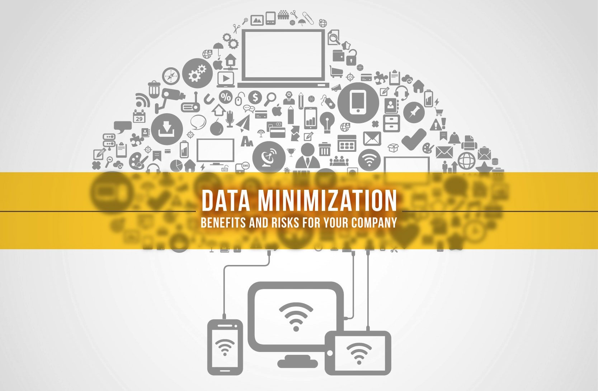
Todays Security Threats
Session 1
Security+
Data Protection Techniques
Data Protection
Encryption – using encryption algorithms to disguise and protect data while in transit and at rest. (Complete session on Encryption).
Data Minimization – reducing the amount of sensitive (PII) data in any dataset. Using data obfuscation to disguise data and its relevance to an individual. This is a concern in Big Data applications that seek to ingest as much data as possible without concern for privacy and PII.

Slide 11
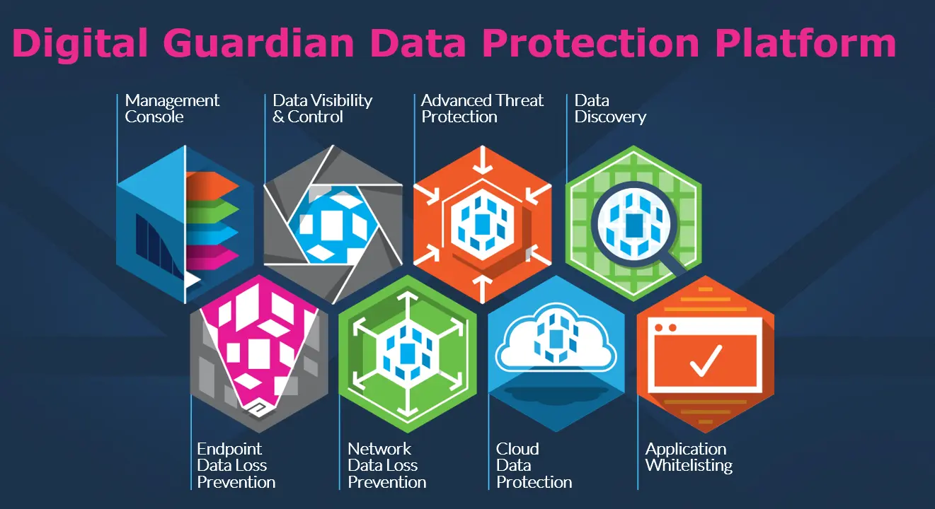
Todays Security Threats
Session 1
Security+
Data Protection Techniques
Data Protection
Data Loss Prevention – data protection policies and procedures for preventing data loss and theft. Network traffic is monitored for potential attempts to remove sensitive information from the company. DLP systems can detect this traffic and move to block the traffic and alert administrators to the attempted data breach.
Host-based DLP Systems
Network-based DLP Systems

Slide 12
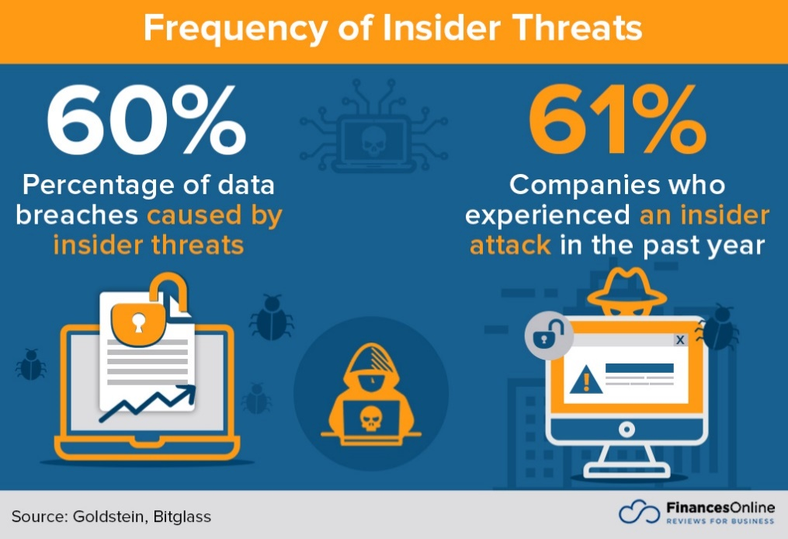
Todays Security Threats
Security+
Session 1
Threat Actors and Attributes
Understanding Cybersecurity Threats
Internal/External – insider threats are the greatest threat to most companies and is very hard to defend against. Most threat countermeasures are focused on external threats.
Sophistication Level/Capability – from unsophisticated script kiddies running downloaded code to advanced persistent threats that exploit zero-day vulnerabilities with sophisticated code developed in their laboratories.
Resources/Funding – nation-states and organized crime have very large or unlimited resources. Hobbyists may just be working in their spare time.
Intent/Motivation – motivations vary. Script kiddies may do it for the thrill, competitors target their attacks to corporate espionage, nation-states for political objectives, organized crime for financial gain.

Slide 13
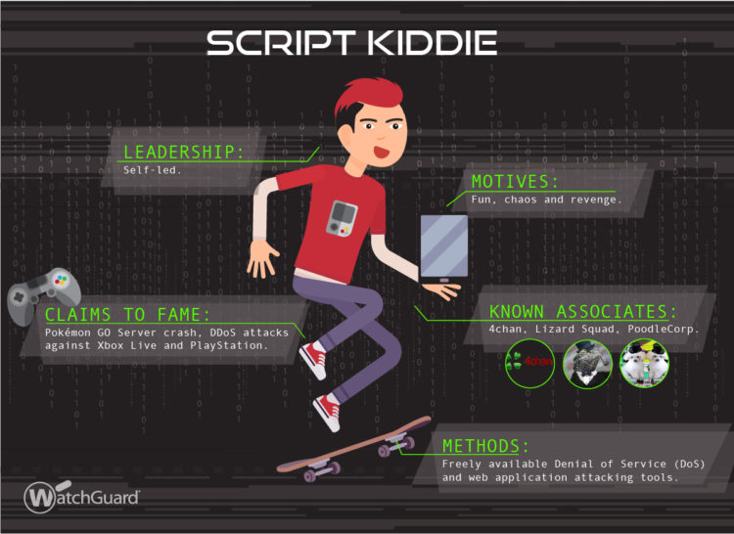
Todays Security Threats
Security+
Session 1
Threat Actors and Attributes
Script Kiddies
Hackers with limited skills that primarily work with automated tools they download from the internet. There are a significant number of tools available as free downloads that can cause damage to a network, such as Denial of Service, disseminating viruses, Trojans or distributing ransomware.
These are the entry level hackers, just getting into it and developing their skills.

Slide 14
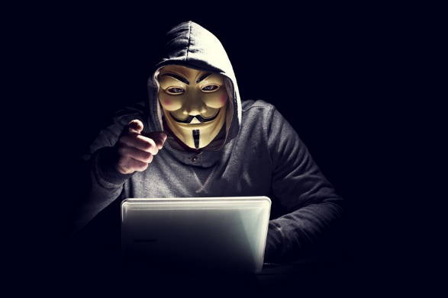
Todays Security Threats
Security+
Session 1
Threat Actors and Attributes
Hacktivist
Hackers that attack web sites for activist or political motives to promote their own ideas and agenda. These are hackers with personal motivations to hack a network to promote their ideas. The Hacktivist can do very little damage, such as deface the home page of a company or institution, or significant damage such as Denial of Service, distributing viruses, or other damaging malware, or releasing confidential information from the organization.
The hacking group Anonymous claims to be a Hacktivist group.

Slide 15
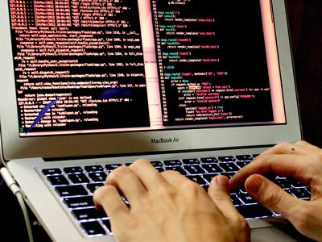
Todays Security Threats
Security+
Session 1
Threat Actors and Attributes
Organized Crime
Organized criminal groups have found that hacking for profit can be lucrative and have been involved in cyber-crime for many years.
The motive and intent is illegal profit, such as hacking personal bank accounts and draining the money from the accounts. Also distributing ransomware for profit can be lucrative. The hacking is not for political reasons or any activist causes.

Slide 16
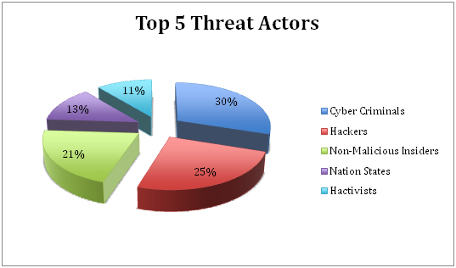
Todays Security Threats
Security+
Session 1
Threat Actors and Attributes
Insiders
Insider threats are the most difficult to protect against because they already have an entrance into the network. An insider threat could have any level of skill from a script kitty to a highly technical person and have any kind of motivation. An insider threat typically works alone and does not have extensive resources.

Slide 17
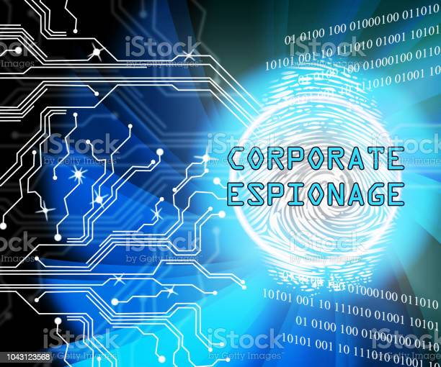
Todays Security Threats
Security+
Session 1
Threat Actors and Attributes
Competitors
Corporate competitors could have significant corporate espionage programs in place to determine corporate secrets.
In some highly competitive industry sectors, corporate espionage can make all the difference in the survival of a company.
This can motivate hacking as a means to determine a competitor’s plans and corporate secrets.

Slide 18
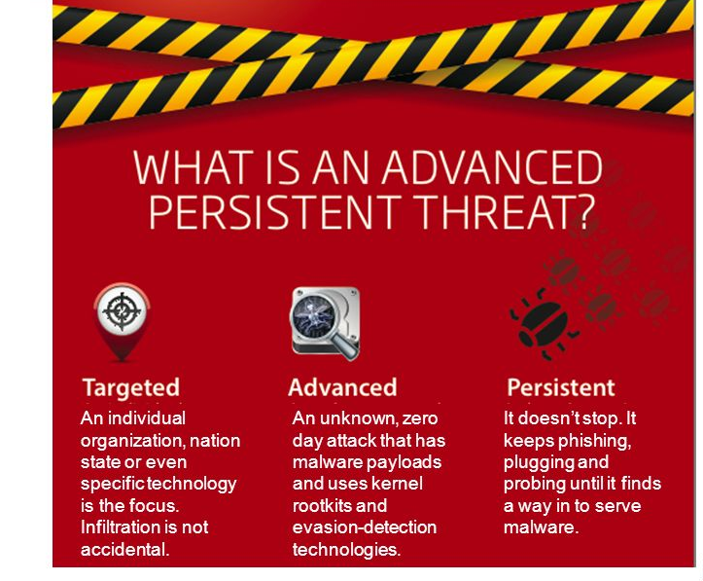
Todays Security Threats
Security+
Session 1
Threat Actors and Attributes
Nation States /Advanced Persistent Threats
Nation states, such as China, Russia, and North Korea have sophisticated cyber warfare organizations that target the United States, as well as other countries to use the cyber network world as an avenue to attack the infrastructure and critical network assets of any potential adversary.
These threat actors are considered Advanced Persistent Threats, (APT) because they have advanced techniques and methods and are persistent in their efforts to attack their targets.
APTs have high (almost unlimited) budget to develop malware and threats and maintain their threat attacks almost indefinitely.

Slide 19
Todays Security Threats
Security+
Session 1
Thank You!!
Send questions and slide deck requests to:
Jim Reeves
Security+, CASP+,CySA+, CISSP, ITILv3, CTT+
MCSE, MCSD, MCT
jireeves@Deloitte.com

